Slide 1

8th Grade Math: Pre-Algebra
Unit 12, Lesson 6 Rewriting Expressions with Common Monomial Factors Volume 2, pg. 242

Slide 2


Benchmark
MA.8.AR.1.3
Rewrite the sum of two algebraic expressions having a common monomial factor as a common factor multiplied by the sum of two algebraic expressions.
volume 2, pg. 242

Slide 3
Integrated Mathematical Thinking and Reasoning Standards
MA.K12.MTR.1.1 Actively participate in effortful learning both individually and collectively.
MA.K12.MTR.3.1 Complete tasks with mathematical fluency.
MA.K12.MTR.4.1 Engage in discussions that reflect on the mathematical thinking of self and others.
volume 2, pg. 242

Slide 4

Learning Target
I can rewrite the sum of two algebraic expressions having a common monomial factor as a common factor multiplied by the sum of two algebraic expressions.
volume 2, pg. 242

Slide 5

Warm-Up
volume 2, pg. 242

Slide 6
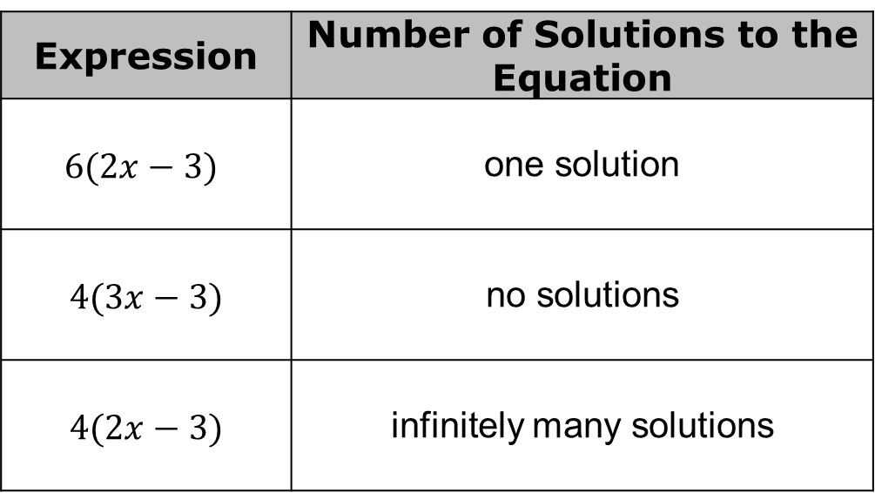
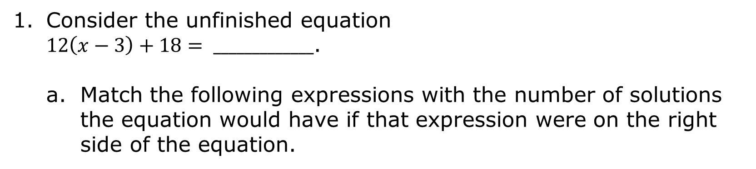
12.6.1 Warm-Up: Matching Solutions
Consider the unfinished equation
$12\left(x−3\right)+18= _____________$.
Match the following expressions with the number of solutions the equation would have if that expression were on the right side of the equation.
Expression | Number of Solutions to the Equation
$6(2x−3)$ | one solution
$$4(3x−3)$$ | no solutions
$$4(2x−3)$$ | infinitely many solutions
volume 2, pg. 242

Slide 7
Explain how you determined which expression would result in an equation with infinitely many solutions.
volume 2, pg. 242

Slide 8

Guided Instruction
volume 2, pg. 243

Slide 9
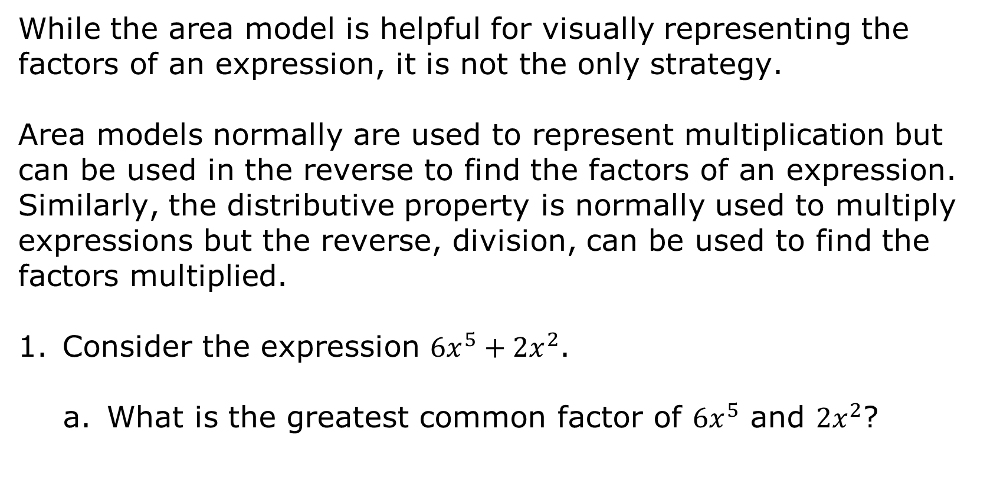
12.6.2 Guided Instruction: Factoring Monomials
While the area model is helpful for visually representing the factors of an expression, it is not the only strategy.
Area models normally are used to represent multiplication but can be used in the reverse to find the factors of an expression. Similarly, the distributive property is normally used to multiply expressions but the reverse, division, can be used to find the factors multiplied.
Consider the expression $6x^{5}+{2x}^{2}$.
What is the greatest common factor of $6x^{5}$ and ${2x}^{2}$?
volume 2, pg. 243

Slide 10

Recall the quotient of powers law of exponents.
$$\frac{a^{m}}{a^{n}}=a^{m−n}$$
Divide both terms in the expression by the GCF determined in Part A.
$\frac{6x^{5}}{ }=$ $\frac{2x^{2}}{ }=$
Rewrite the expression using the distributive property.
( + )
volume 2, pg. 243

Slide 11
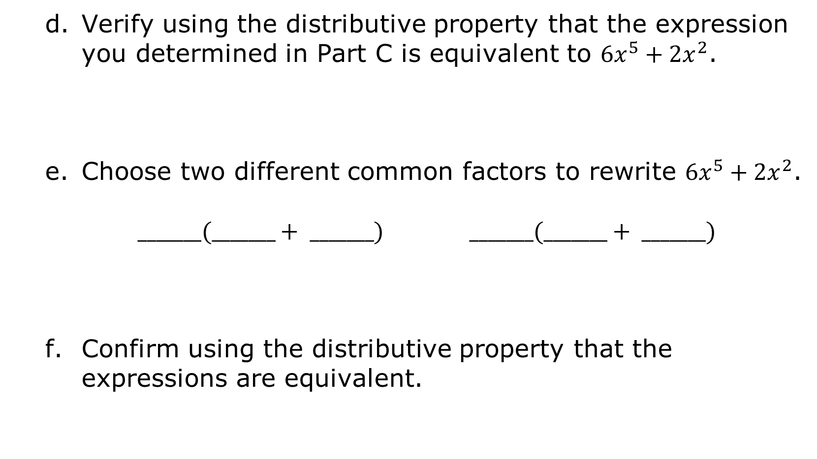
Verify using the distributive property that the expression you determined in Part C is equivalent to $6x^{5}+{2x}^{2}$.
Choose two different common factors to rewrite $6x^{5}+{2x}^{2}$.
$_______(_______+ _______)$ $_______(_______+ _______)$
Confirm using the distributive property that the expressions are equivalent.
volume 2, pg. 243

Slide 12
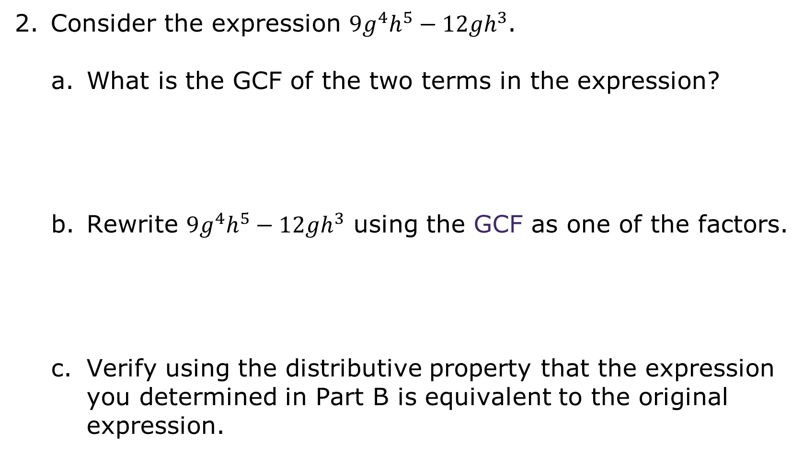
Consider the expression $9g^{4}h^{5}−{12gh}^{3}$.
What is the GCF of the two terms in the expression?
Rewrite $9g^{4}h^{5}−{12gh}^{3}$ using the GCF as one of the factors.
Verify using the distributive property that the expression you determined in Part B is equivalent to the original expression.
volume 2, pg. 243

Slide 13

Collaboration
volume 2, pg. 244

Slide 14

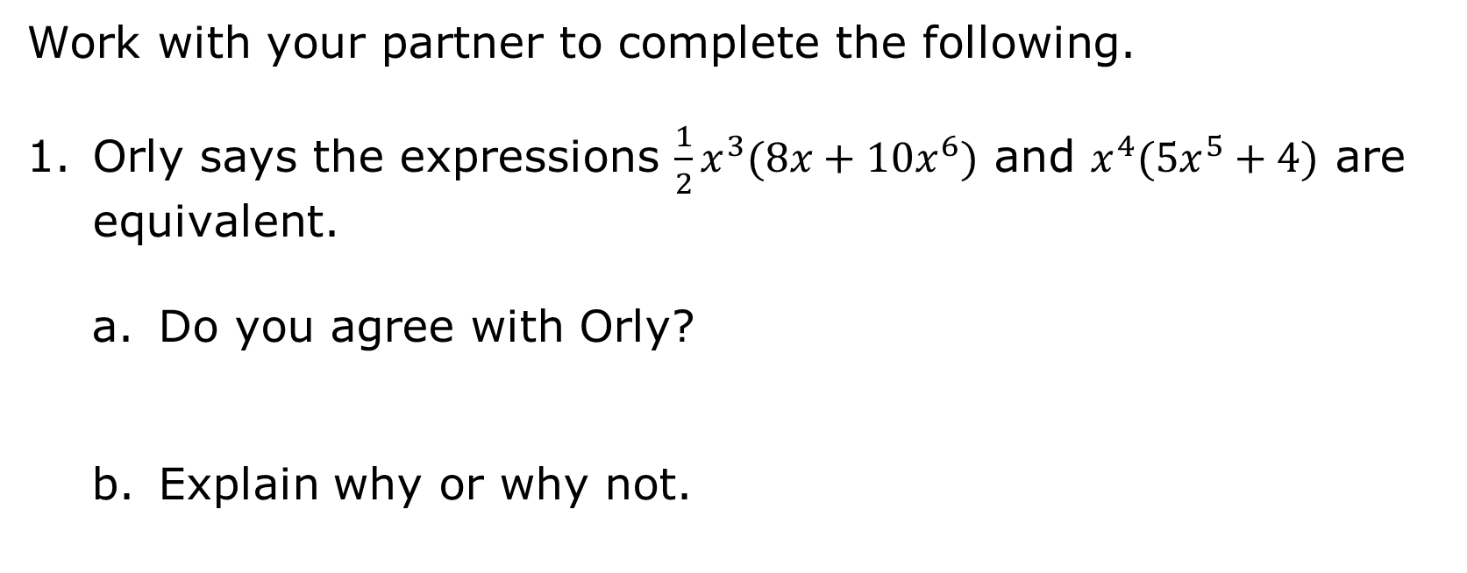
12.6.3 Collaboration: Which Is Equivalent?
Work with your partner to complete the following.
Orly says the expressions ${\frac{1}{2}x}^{3}(8x+10x^{6})$ and $x^{4}({5x}^{5}+4)$ are equivalent.
Do you agree with Orly?
Explain why or why not.
volume 2, pg. 244

Slide 15
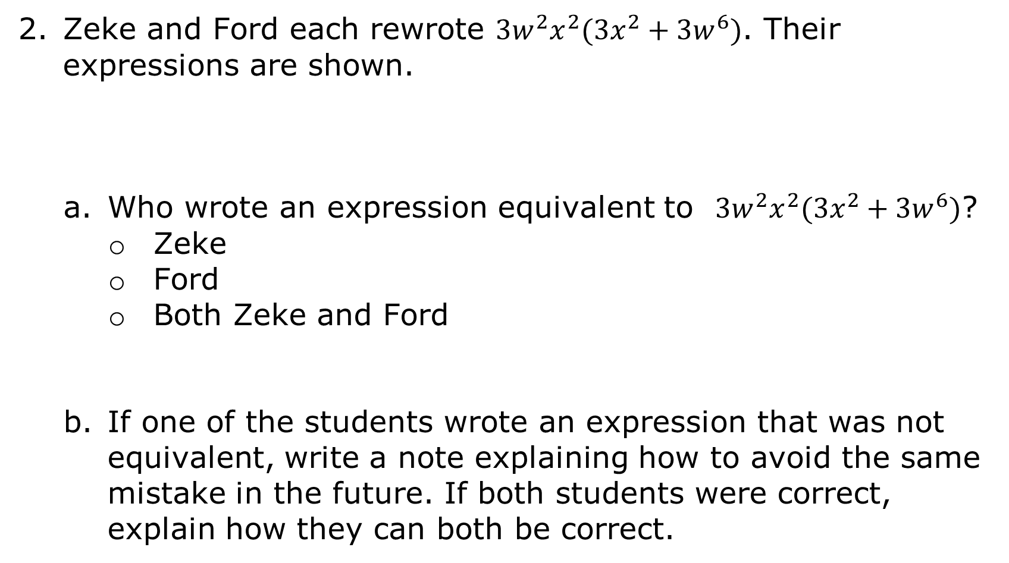
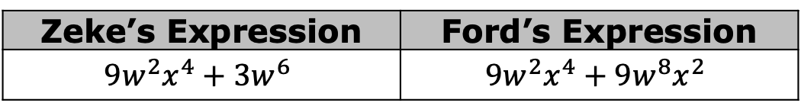
Zeke and Ford each rewrote ${3w}^{2}x^{2}(3x^{2}+3w^{6})$. Their expressions are shown.
Who wrote an expression equivalent to ${3w}^{2}x^{2}(3x^{2}+3w^{6})$?
Zeke
Ford
Both Zeke and Ford
If one of the students wrote an expression that was not equivalent, write a note explaining how to avoid the same mistake in the future. If both students were correct, explain how they can both be correct.
Zeke’s Expression | Ford’s Expression
$${9w}^{2}x^{4}+3w^{6}$$ | $${9w}^{2}x^{4}+9w^{8}x^{2}$$
volume 2, pg. 244

Slide 16
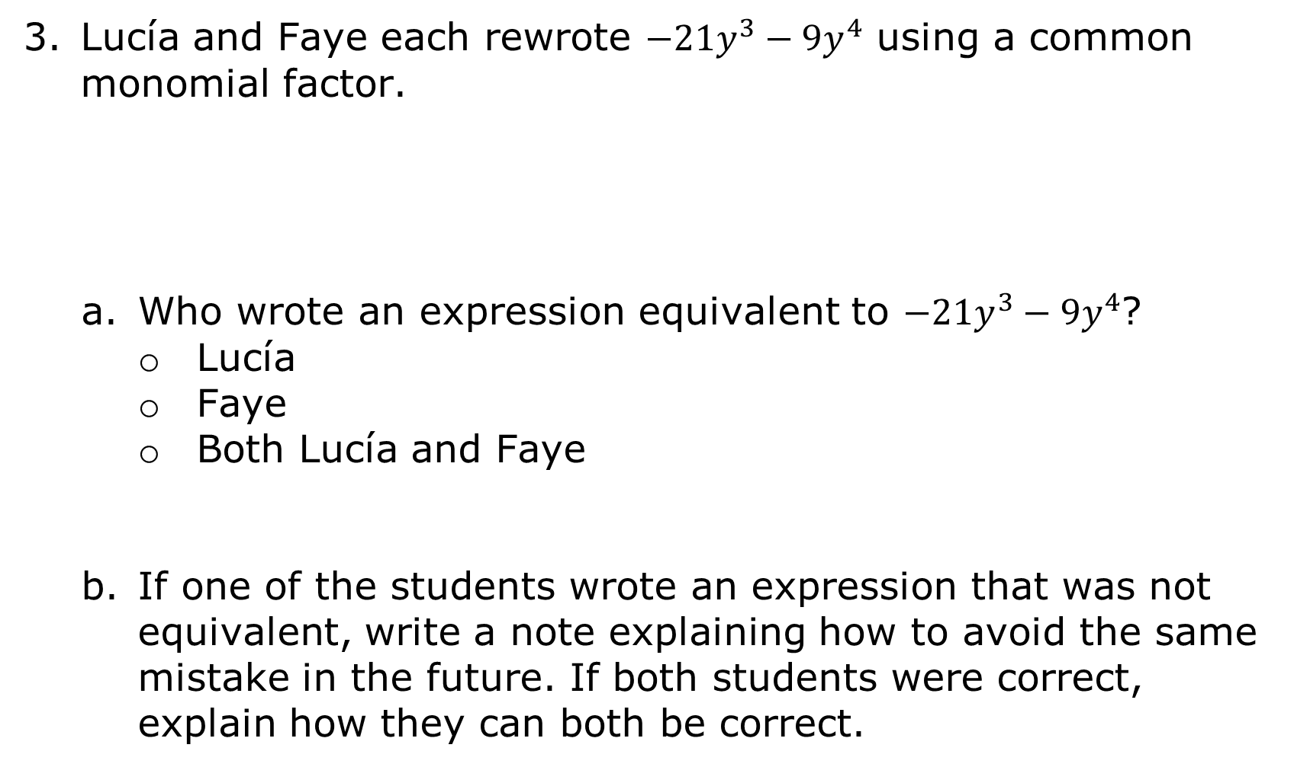
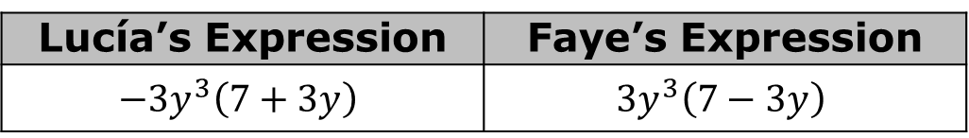
Lucía and Faye each rewrote $−21y^{3}−9y^{4}$ using a common monomial factor.
Who wrote an expression equivalent to $−21y^{3}−9y^{4}$?
Lucía
Faye
Both Lucía and Faye
If one of the students wrote an expression that was not equivalent, write a note explaining how to avoid the same mistake in the future. If both students were correct, explain how they can both be correct.
Lucía’s Expression | Faye’s Expression
$$−3y^{3}\left(7+3y\right)$$ | $$3y^{3}\left(7−3y\right)$$
volume 2, pg. 244

Slide 17

Activity
volume 2, pg. 245

Slide 18

12.6.4 Activity: Matching Expressions
Six expressions are provided in the table.
Work with your partner to find two expressions from the card set that are equivalent to each given expression. Write the letter of each card in the columns labeled Card 1 and Card 2. Then, create an additional equivalent expression not included on either card in the last column.
volume 2, pg. 245

Slide 19
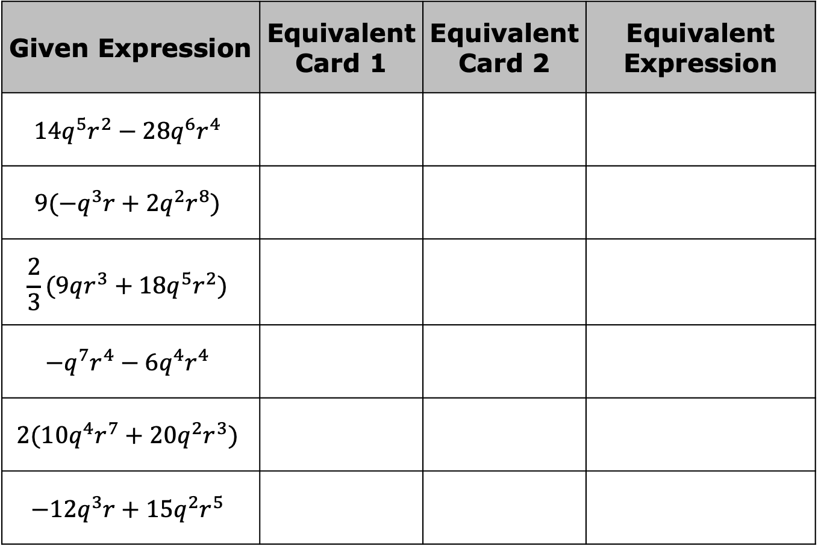
Given Expression | Equivalent Card 1 | Equivalent Card 2 | Equivalent Expression
$$14q^{5}r^{2}−28q^{6}r^{4}$$
$$9({−q}^{3}r+2q^{2}r^{8})$$
$$\frac{2}{3}(9qr^{3}+18q^{5}r^{2})$$
$$−q^{7}r^{4}−6q^{4}r^{4}$$
$$2(10q^{4}r^{7}+20q^{2}r^{3})$$
$$−12q^{3}r+15q^{2}r^{5}$$
volume 2, pg. 245

Slide 20

Your Turn
volume 2, pg. 245

Slide 21
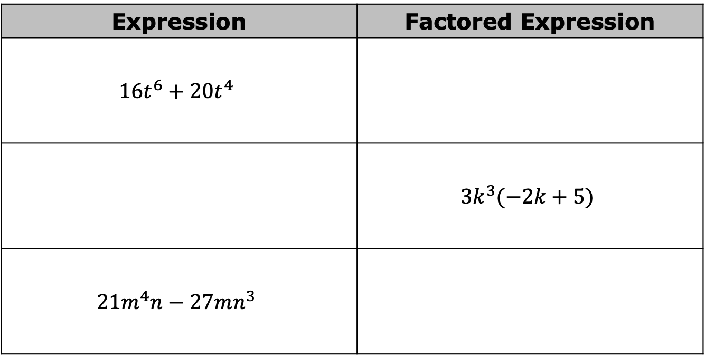
12.6.5 Your Turn!
Complete the table.
Expression | Factored Expression
$${16t}^{6}+20t^{4}$$
 | $${3k}^{3}(−2k+5)$$
$${21m}^{4}n−27mn^{3}$$
volume 2, pg. 245

Slide 22

Wrap-Up
volume 2, pg. 246

Slide 23





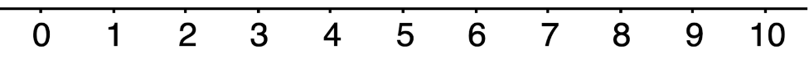
12.6.6 Wrap-Up: Reflection
Rate your understanding of today’s learning target on the emoji scale.
I can rewrite the sum of two algebraic expressions having a common monomial factor as a common factor multiplied by the sum of two algebraic expressions.
volume 2, pg. 246

